Slide 1



Managing Authority CAP SP
I73.1 – On-Farm Non-Productive Investments (Afforestation)
Launched: 27th January 2025
Info session: 7th February 2025

Slide 2

INTERVENTION DETAILS
Budget: €1.25 million in total (public expenditure)
Support rate: 80% of the eligible costs
Deadline: 28th March 2025 at 12:00hrs
Maximum Duration of the project : 24 Months
The call is open for On-Farm Non-Productive Investments related to:
Afforestation

Slide 3
ELIGIBLE APPLICANTS
Support under this intervention is available to:
Farmers
Partnerships (Farmers)

Slide 4
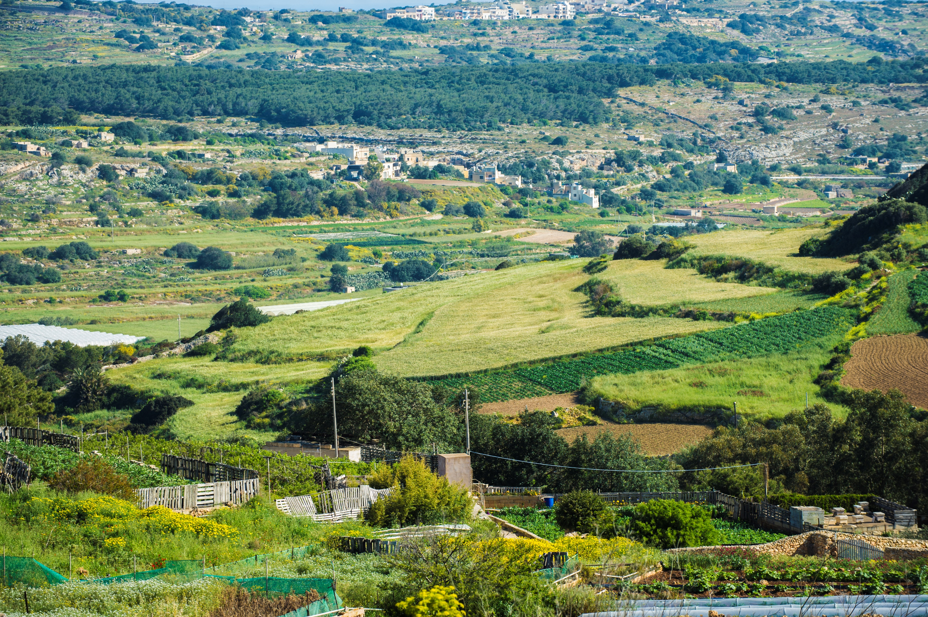
ELIGIBLE ACTIONS
• Support for planting of trees and ancillary works
  Planting of new trees
  Removal of invasive alien tree species
  7% Indirect cost

Slide 5
What is required at application stage?
Expenditure is considered to be eligible expenditure and therefore eligible for reimbursement only if it has been incurred after an application has been submitted to the Managing Authority
Application Form
Application Form
Management Plan

Slide 6
What is required at application stage?
Management Plan
1. General Information:
Location of the proposed project with coordinates (The minimum size of the area to be supported for the purpose of afforestation is defined as a land area of 0.5 ha or more and which has (or will have following afforestation actions) a minimum tree cover of 10%.)
Site Plan endorsed by an architect as to current status of site including;
  Total Area in SQM
  Percentage of tree cover
  Trees marked on Site Plan with a clear legend

Slide 7
What is required at application stage?
2. Forest Description:
Site Plan endorsed by an architect as how site is envisaged to be after project implementation including;
Total Area in SQM
Indicative Percentage of tree cover
Trees marked on Site Plan with a clear indicative legend
In case of removal of invasive alien tree species, a list of trees duly indicated on Site Plan. This should be supported by photographic evidence.

Slide 8
What is required at application stage?
3. Management Objectives:
Objectives for the woodland/forest creation (Approximately 100 words)

Slide 9
INELIGIBLE EXPENDITURE
Restoration or rebuilding of Rubble Walls
Equipment & Machinery
Tree planting for purposes not in line with this sub-measure.
Investments directly or indirectly linked to private dwellings/accommodation/hotels/etc.
Private and Public amenities.

Slide 10
Assessment and Selection of Applications
In cases where applications need to be prioritised in view of budgetary limitations, priority will be given to:
a) operations within a Natura 2000 area.
b) If further prioritisation would be required, then the next criterion would be proximity to Natura 2000 areas.

Slide 11
CHANGE REQUESTS/PAYMNETS
Projects with a grant value of equal or less than EUR100,000 shall be limited to two (2) change request submissions, including extension requests, whereas projects with a grant value of more than EUR100,000 but less than or equal to EUR200,000 shall be limited to three (3) change request submissions. The limit of change request submissions applies for the entire duration of the project. For the avoidance of doubt, the limitation is subject to the number of submissions and not the amount of changes requested per submission. Furthermore, the limitation still applies in case the MA rejects the request in part or in its entirety.

Slide 12
DURABILITY
For investments with a grant value of up to €15,000 the durability period obligations will extend to one (1) year from the final payment to the beneficiary.
For investments with a grant value of between €15,000 and €200,000 the durability period obligations will extend to three (3) years from the final payment to the beneficiary.
For investments with a grant value of over €200,000 the durability period obligations will extend to five (5) years from the final payment to the beneficiary.

Slide 13
CONTACT US
AGRI Managing Authority
Tel: 2555 2692
Email: fondi.eu@gov.mt
Servizz Ewropej f’Malta
Tel: 2779 7300
Email: info.sem@gov.mt

Slide 14

Contact Details
Website: sem.gov.mt
Email: info.sem@gov.mt
Telephone line: +356 27797300
Office address: 280, Republic Street, Valletta

Slide 15


